Slide 1
Bike Rental Company Performance Analysis
Business Insights Using Weather, Temperature & Customer Data
By:-
Nipesh Ushank
11ds280126-1189
Digicrome
NextHikes IT Solutions

Slide 2
Introduction
• Analyze bike rental performance using customer and environmental data.
• Study the impact of weather, temperature, weekdays, and customer categories.
• Identify peak rental periods and customer behavior patterns.
• Improve operational planning, marketing, and profitability.

Slide 3
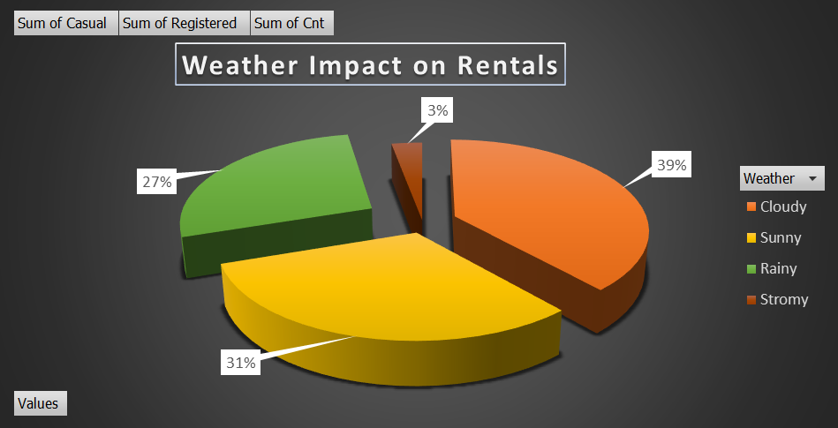
Weather Impact on Rentals
• Cloudy weather recorded the highest rentals (39%).
• Sunny weather contributed 31% of total rentals.
• Rainy weather reduced customer demand.
• Stormy weather generated the lowest rentals (3%).
• Moderate weather conditions increase bike usage.

Slide 4
Weather Insights & Recommendations
• Weather strongly affects customer decisions.
• Forecasting helps manage bike inventory.
• Offer rainy-day discounts and promotions.
• Provide safety accessories during poor weather.

Slide 5
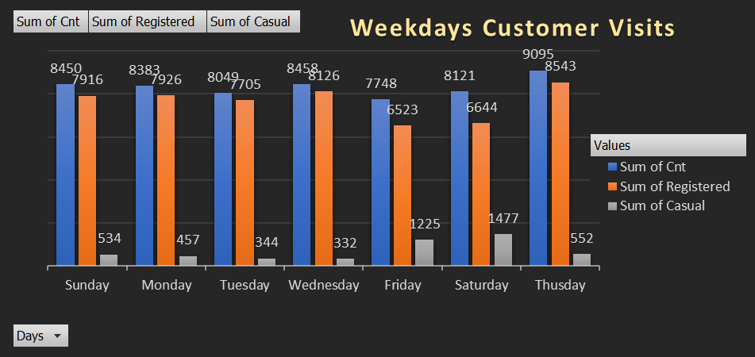
Weekday Customer Visits Analysis
• Thursday recorded the highest rentals (~9,095 customers).
• Registered users contribute the majority of rentals.
• Casual riders increase during weekends.
• Weekday commuting drives rental demand.

Slide 6
Weekday Business Recommendations
• Increase bikes during peak weekday hours.
• Launch loyalty programs for registered users.
• Introduce weekend packages for casual riders.
• Improve demand-based inventory planning.

Slide 7
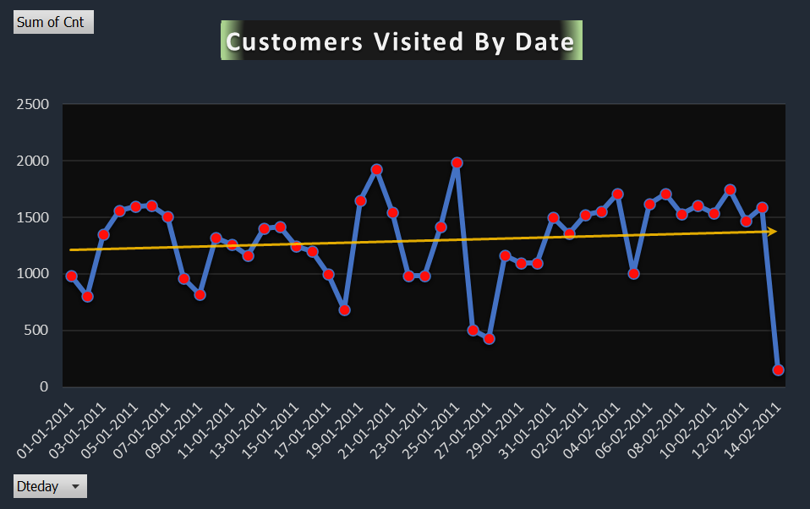
Customer Visits by Date
• Daily rentals fluctuate over time.
• Peak rental days reached nearly 2,000 customers.
• Low-demand days may occur due to weather or holidays.
• The trendline shows steady business growth.

Slide 8
Customer Visit Insights
• Customer demand is increasing steadily.
• Predictive analytics can improve planning.
• Increase inventory during high-demand periods.
• Monitor trends for operational efficiency.

Slide 9
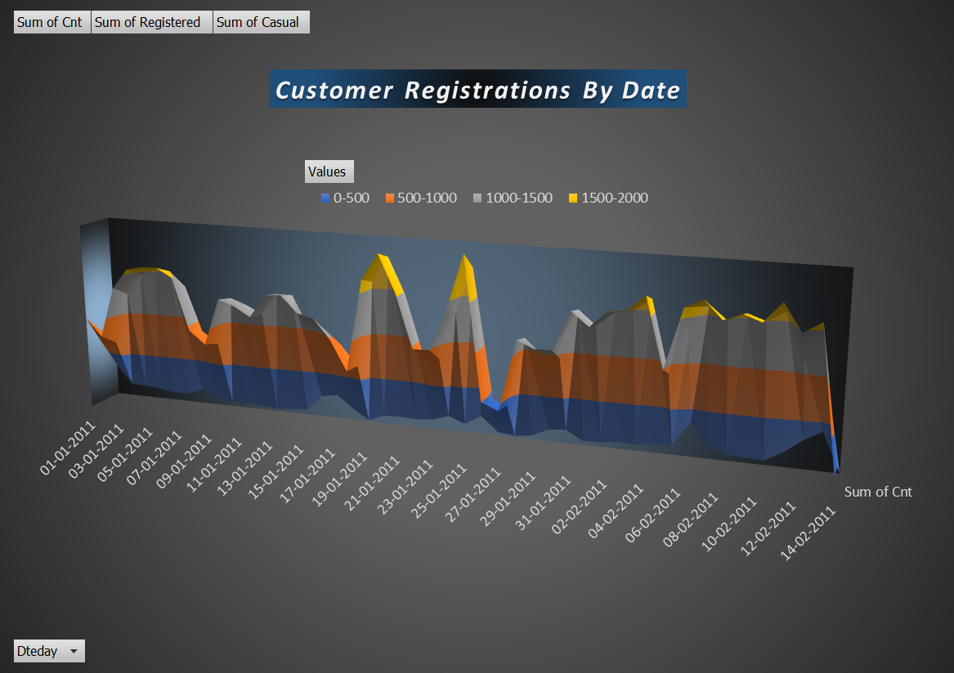
Customer Registrations by Date
• Most registrations fall between 500–1500 users.
• Some dates exceeded 1500 registrations.
• Registrations depend on weather and seasonal demand.
• Stable registrations indicate strong engagement.

Slide 10
Registration Recommendations
• Launch targeted marketing campaigns.
• Improve digital registration systems.
• Offer incentives for new users.
• Focus on customer acquisition strategies.

Slide 11
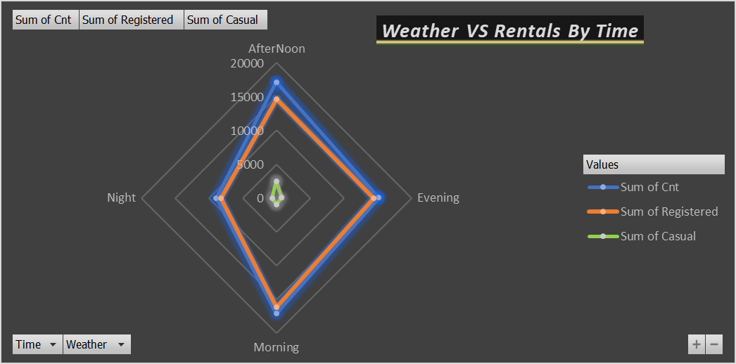
Weather vs Rentals by Time
• Morning rentals are high due to commuting.
• Afternoon rentals remain stable.
• Evening rentals show the highest activity.
• Night rentals remain comparatively lower.

Slide 12
Time-Based Rental Insights
• Peak demand occurs during commuting hours.
• Increase bike availability in mornings and evenings.
• Improve lighting and rider safety.
• Introduce evening membership plans.

Slide 13
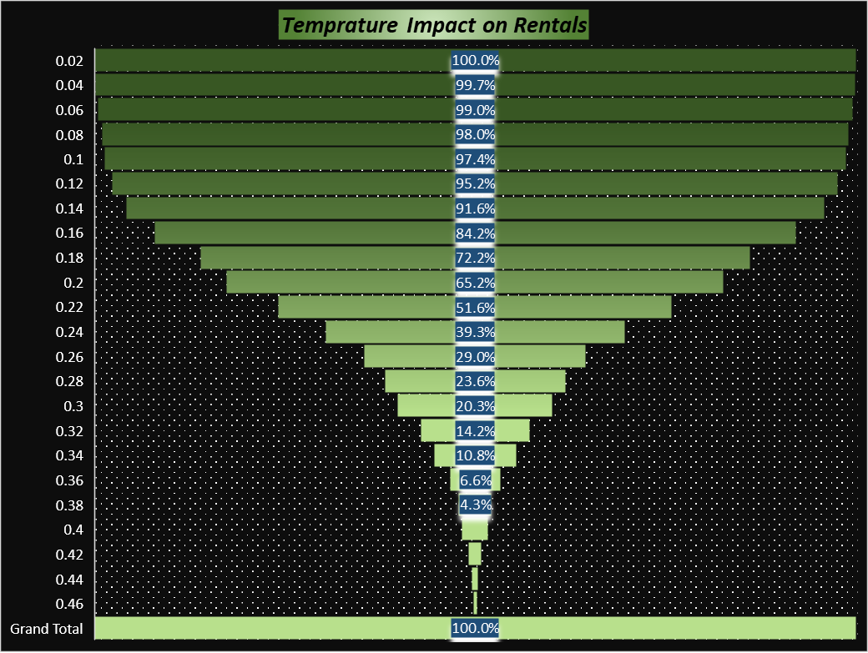
Temperature Impact on Rentals
• Moderate temperatures generate the highest demand.
• Cold weather reduces customer activity.
• Extremely hot weather lowers comfort.
• Temperature strongly affects rental behavior.

Slide 14
Temperature Recommendations
• Introduce seasonal pricing strategies.
• Offer winter discounts to maintain activity.
• Promote rider safety during hot weather.
• Use seasonal marketing campaigns.

Slide 15
Overall Business Performance Summary
• Strong registered customer base.
• Rental demand is increasing steadily.
• Favorable weather improves customer activity.
• Opportunities exist in loyalty programs and promotions.
• Challenges include weather dependency.

Slide 16
Final Conclusion
• The company shows stable and growing performance.
• Weather and temperature significantly affect rentals.
• Registered customers generate major revenue.
• Strategic planning can maximize profitability.
• Customer-focused marketing improves growth.

Slide 17
Thank You
Bike Rental Company Performance

